Slide 1
2025 Budget Preview
May 30, 2024

Slide 2
Outline
Schedule
Improvements
Communications
Commission Questions

Slide 3
Schedule
Staff
CIP Prep.
Op. Bud. Prep
Op. Bud.
Financial Plan
Commission
Process & Coll. Sys. Preview
Financial Preview
Commun- ications
Preparation
Op. Bud.
Financial Plan
Financial Plan
Rates/Fees
Document
Rates/Fees
…May
June
July
Aug.
Sep.
Oct.
Nov.
Rates Sent,
Closeout.
Rates/Fees
Exec. Office & Directors
Process Guidance
CIP Decisions
Op. Bud Decisions.
Introduction,
Hearing
Questions.
Early Touchpoints
Message Development
Community Outreach & Engagement
Community Outreach & Engagement
Deliberation, Adoption.
Months
Director Discussions

Slide 4
Improvements
No draft capital improvements plan (CIP)
Study sessions
Budget intro
Collection system facilities plan
Finances
Capital projects dependencies & resources
Communications…

Slide 5
Communications
Led by Communications & Public Affairs
Coordinated with Executive Office, Directors, and Budget & Planning
Community outreach & engagement (driven by data from focus groups)
Commission role
Commun- ications
Preparation
…May
June
July
Aug.
Sep.
Oct.
Nov.
Questions
Early Touchpoints
Message Development
Community Outreach & Engagement
Community Outreach & Engagement
Months

Slide 6
Questions
Questions on presentation?
For ongoing consideration:
Role in owner community engagement?
Information & issues before approval?
Technical questions?

Slide 7
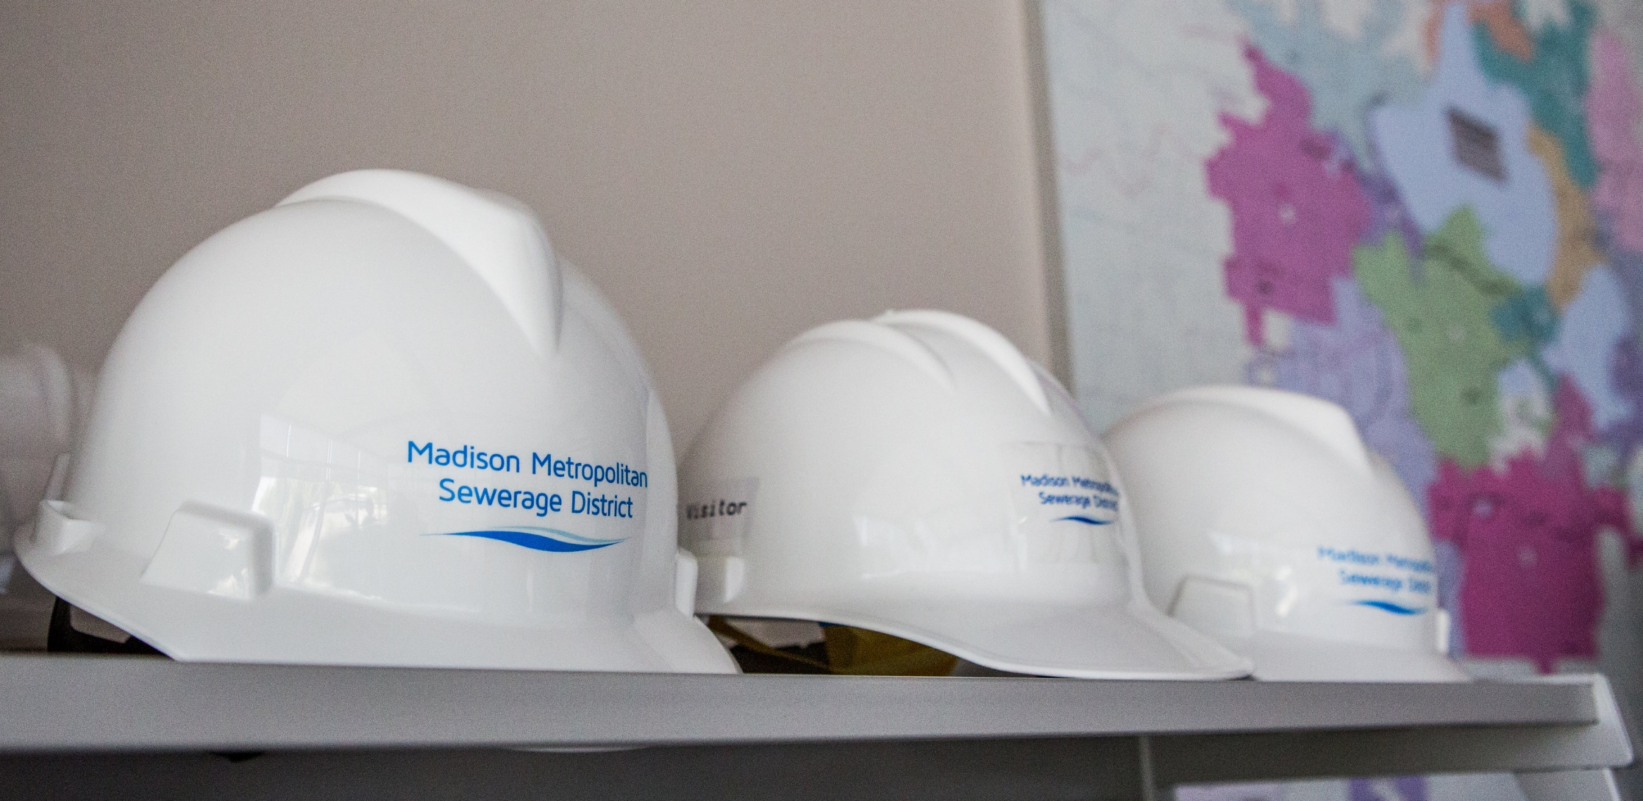
Thank You

