Slide 1
Nine Springs Valley Interceptor – Mineral Point Extension:
Pipe Investigation Update
Commission Meeting
August 8, 2024

Slide 2
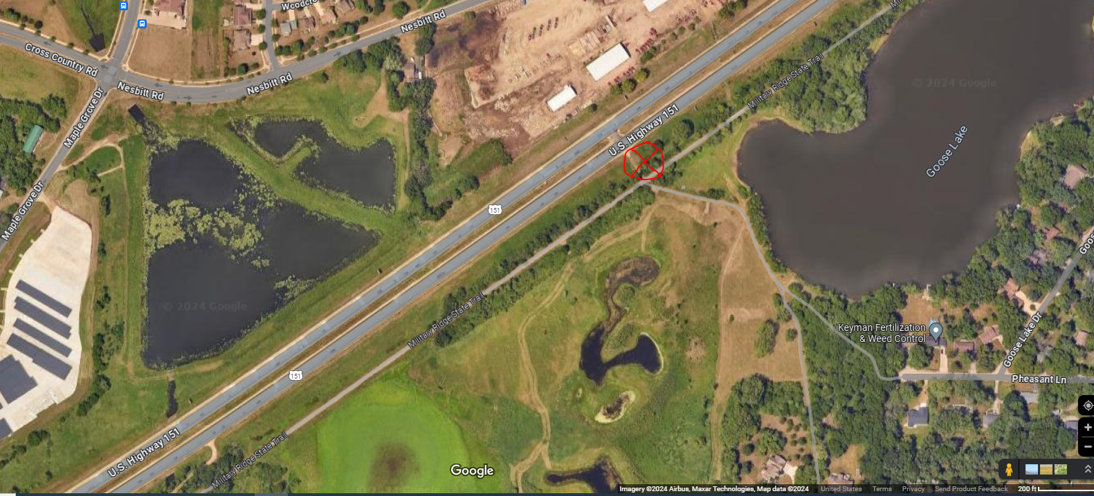
Agenda Location Map
Staff introduction
Location
Action items completed
Action items in process
Questions
To Fitchburg / Madison
To Verona
Pipe investigation location

Slide 3
Action items completed
Televising investigations
Daily flow monitoring and surface observations
By-pass pumping system operational
Updates to staff
Additional televising investigation
Pipe repair coordination meeting
Construction of earth retention system (pit)
Cleaning of pipe
Construction of dewatering system
Photo: Monday 7/29/2024
By-pass pumps

Slide 4
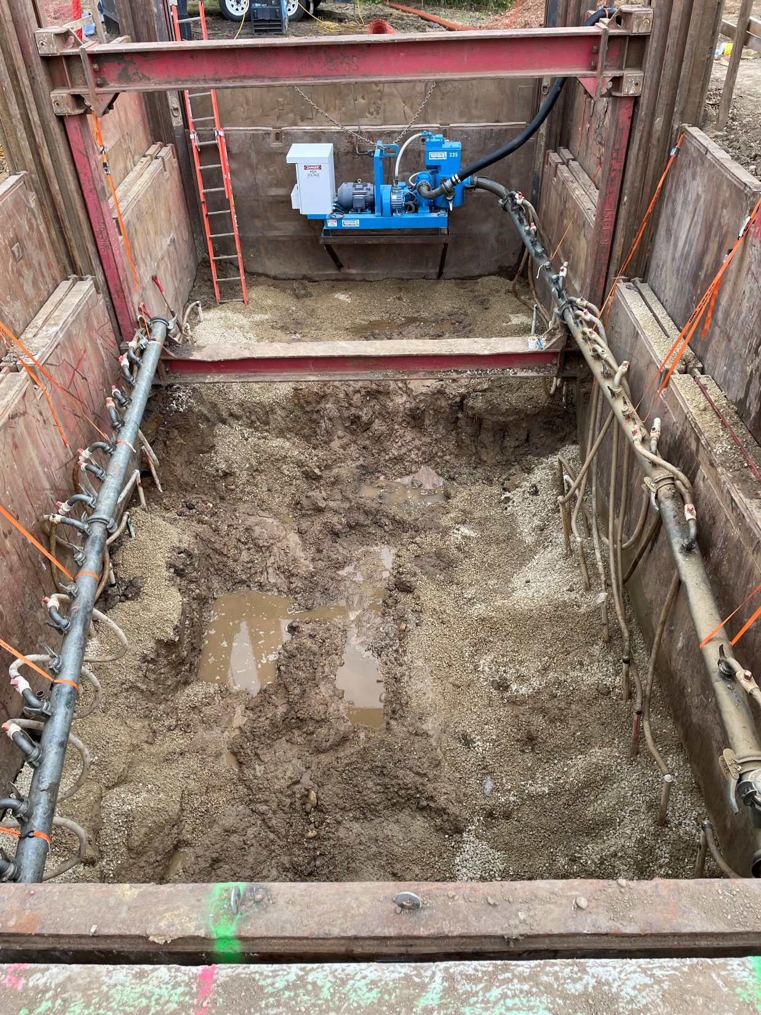
Action items in process
Grouting of soil
Obtain materials for pipe repair
Pre-plan meeting for pipe repair
Perform pipe repair
Clean and inspect pipe
Restoration
Photo: Monday 8/5/2024
Pit with dewatering system

Slide 5
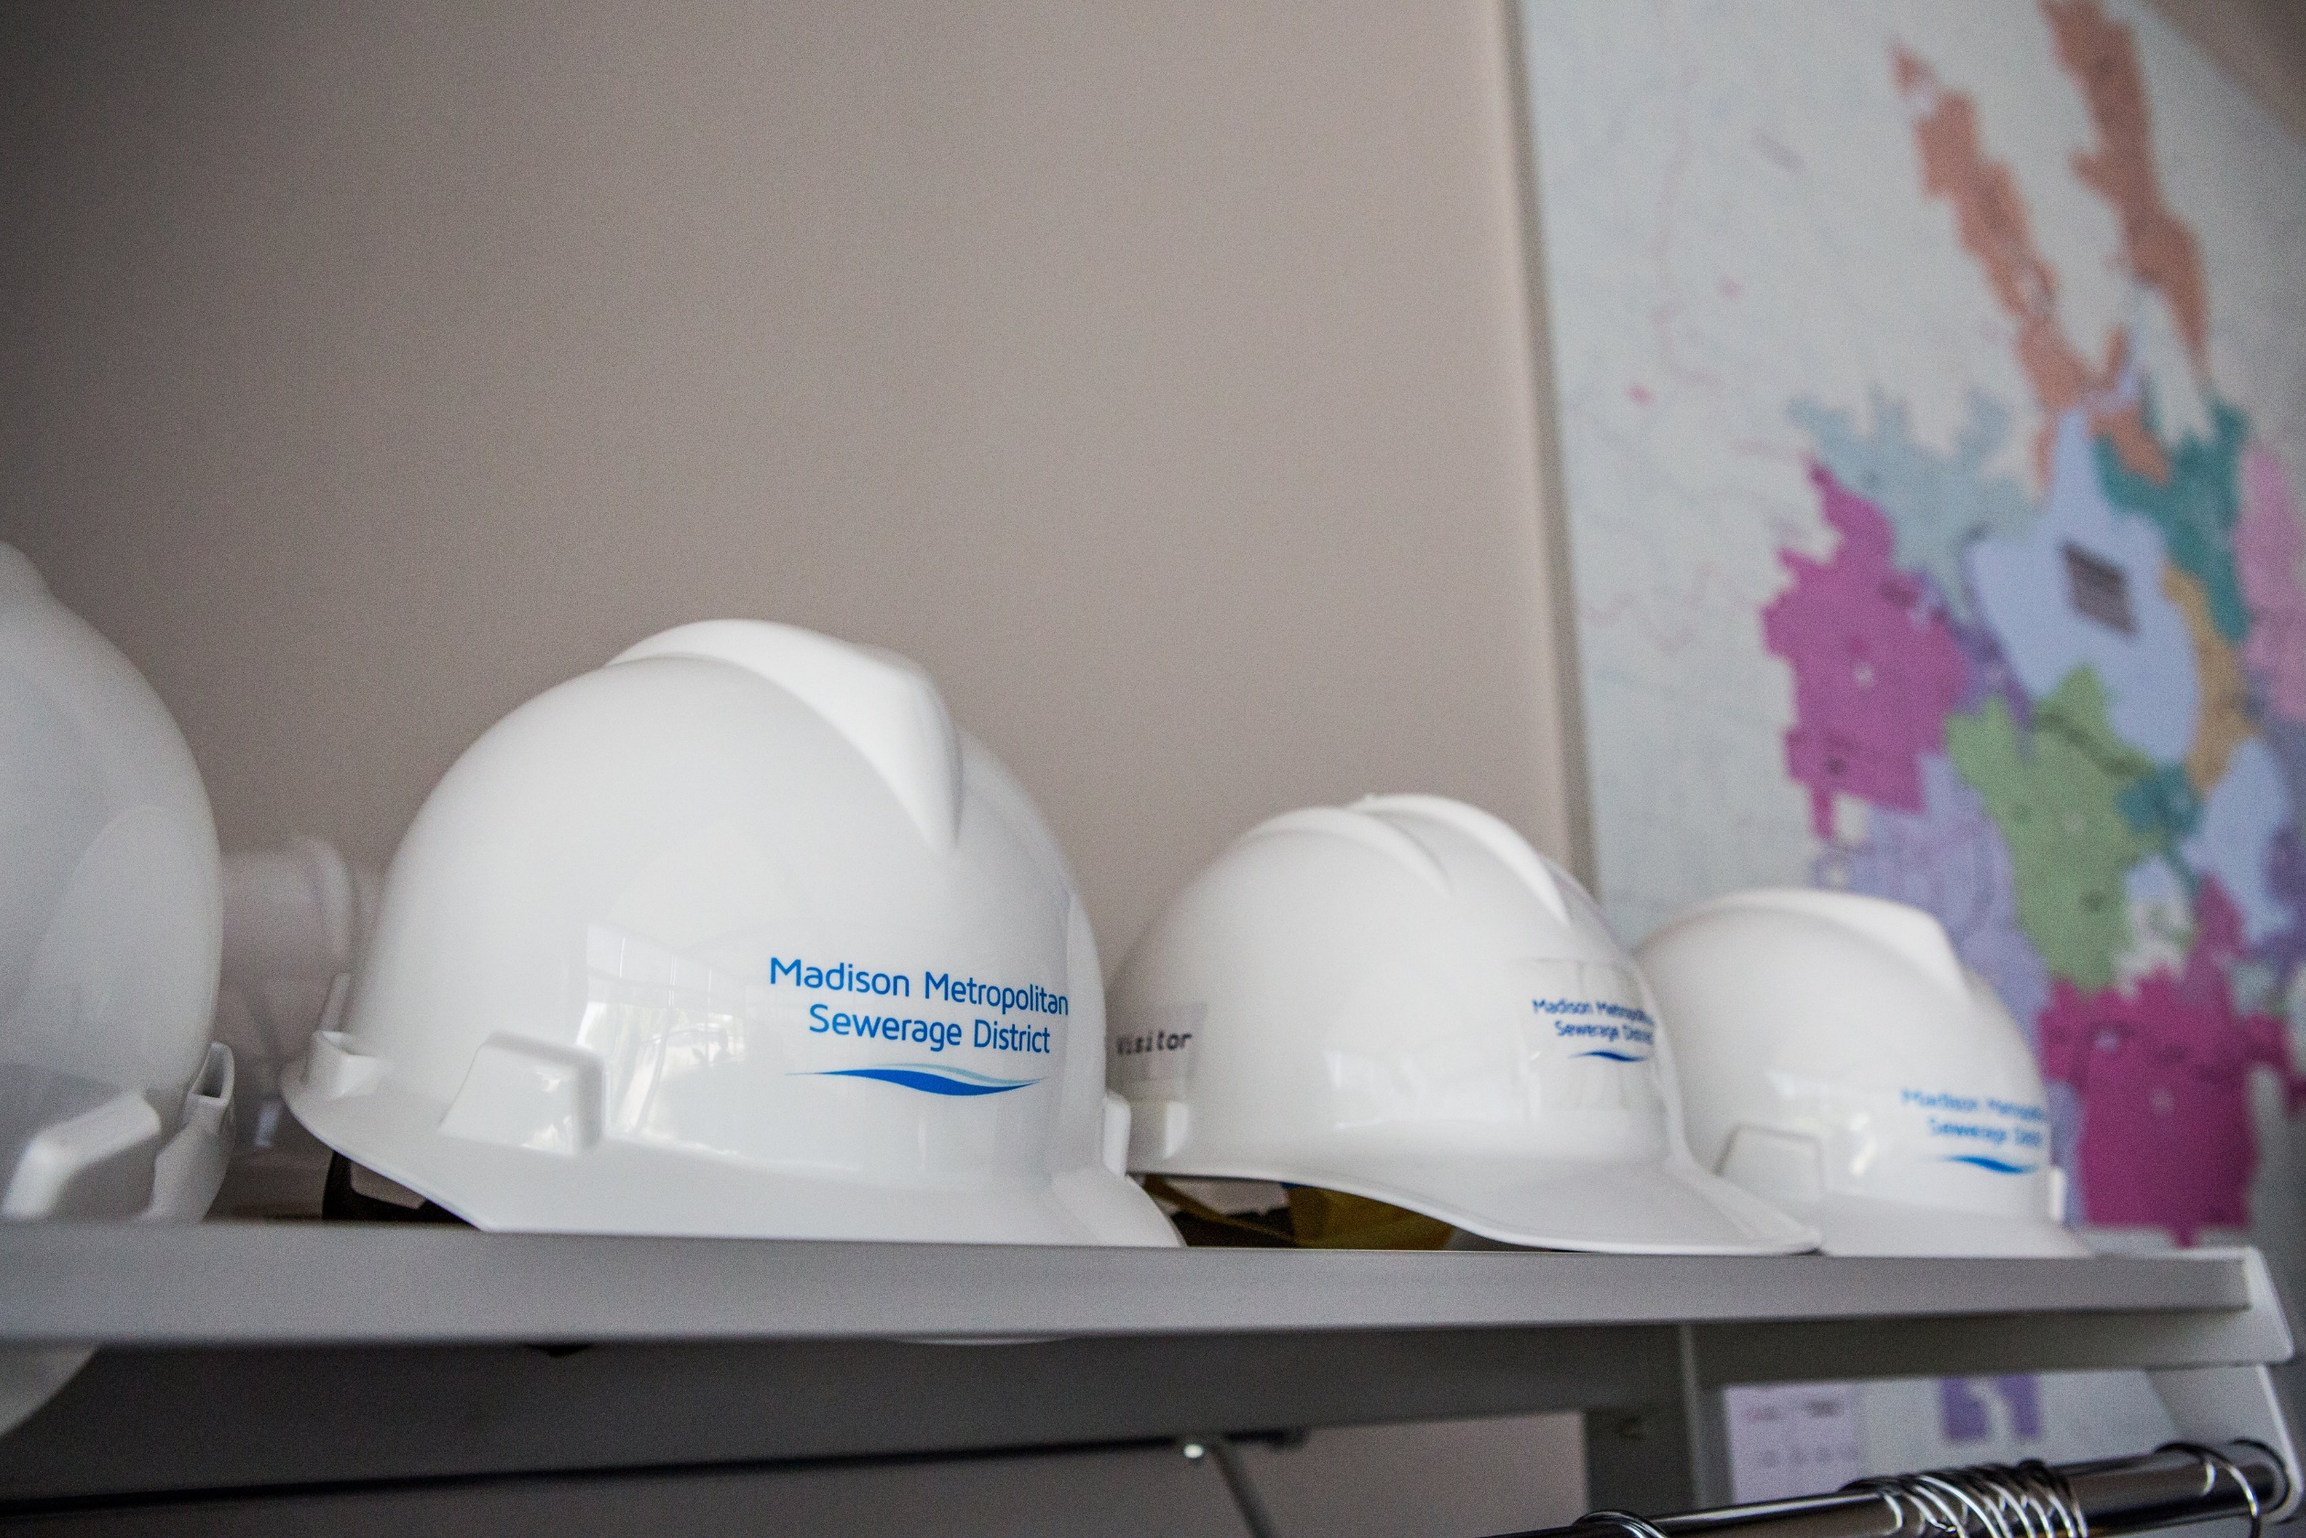
Questions?

