Slide 1
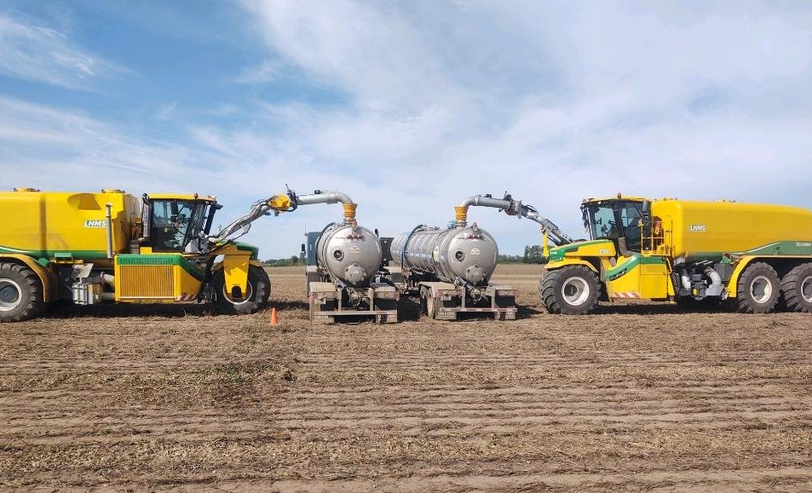
Metrogro Software System Development
August 8, 2024
Notes:
Good morning, I’m Laurie Dunn, I’m one of the DTM. I’m here today to provide you with some information about the Metrogro Software System Development project.

Slide 2
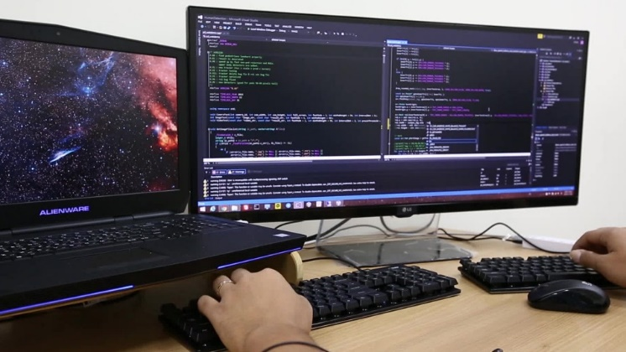
Today’s Presentation…
Current software system
Reasons to move to a new system
Requirements gathering
Our RFP and evaluation of proposals
Selection of American Technology Consulting (ATC)
Project timeline
Time for questions
Notes:
During today’s presentation I’ll …
Briefly describe the current Metrogro software system, its’s history, and why we need to replace it
I’ll describe the process that we used to gather and prioritize requirements for that new system,
And then the path we took for creating the respective RFP.
I’ll provide background on the process the project took to evaluate the proposals received
And include information on our selected consultant, ATC, and describe what put them ahead of the other firms
And then there will be some time for questions

Slide 3
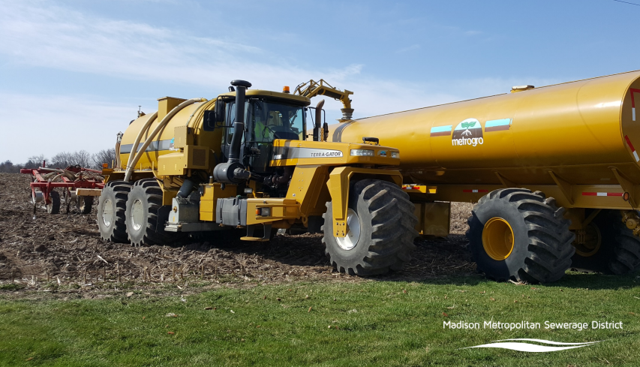
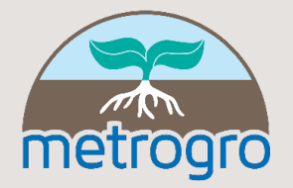
The Metrogro Program
Service Area: Dane, Green, Columbia, Rock, Jefferson, and Dodge countries
Annually…
Gallons applied – 38,000,000
Semi trailer loads – 7,100
Acres applied – 5,500
Notes:
Metrogro is high performing program that is essential for plant operations, and it provides benefits to area farmers
Metrogro biosolids applications cover multiple counties – not only Dane, but also Green, Rock, Columbia, Jefferson, and Dodge counties
On an annual basis Metrogro moves approximately 38M gallons of the District’s biosolids - that have been recovered from our treatment processes - onto area farm fields.
Annually this comes out to about 7100 semi trailer loads covering 5500 acres

Slide 4
The Metrogro Program
Recovers Resources
Reduces commercial fertilizer
Saves Taxpayers
Follows regulatory guidance
Manages biosolids quality
Notes:
Other benefits of the Metrogro program include
Promoting sustainability through resource recovery
Reducing the use of commercial fertilizer
Saving taxpayer dollars by reducing the District’s storage costs,
Assuring public health and safety through alignment of our biosolids applications with regulatory guidance from the DNR and EPA, and continuous monitoring of biosolids quality

Slide 5
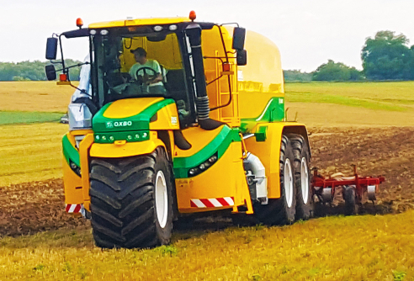
How Software Supports the Metrogro Program
Calculating applications rates
Tracking field applications
Importing, processing, and reporting data
Regulatory data submittals
Historical data repository
Customer tracking
Notes:
Our software system supports the Metrogro program in multiple ways including
Calculating biosolids application rates
Providing a record keeping system to record trips to farm-fields, applications, and biosolids quality data
Managing farmer customer information
Processing records for reports and submittals to regulatory agencies
Maintaining a history of those regulatory reports
Providing tools to assist users with looking at trends in important biosolids analytical and field application data

Slide 6
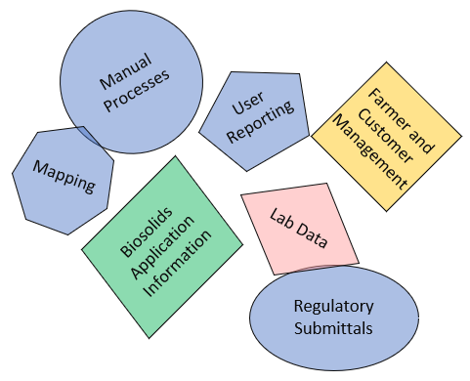
Current Software System Challenges
Developed over 20+ years ago
Platform has limited extensions
Fragmented, unconnected data
Small set of development tools
Many manual processes
Increasing support hours
Limited reporting tools
Unable to properly support
Notes:
Our current Metrogro software system was developed on a Microsoft Access platform over 20+ years ago
Because of its age and the limitations of the Access platform, we are experiencing several significant challenges
For many years IT and Metrogro staff have worked to extend the system with enhancements and reconfigurations to cover new needs, this takes time, and the work is increasingly complicated
Additionally, as the system has been extended, it has also become increasingly fragmented, and this fragmentation makes it difficult to manage and easily understand
For processes that are not easily automated using Access tools, we have resorted to manual processes and external integrations – and these have further fragmented the system
We are also limited by Access’s reporting tools, so more sophisticated and helpful reporting, dashboards, and business intelligence tools are not available – these are common in more modern systems, and they are becoming expectations of staff
We feel that now is the time to look for a new software system

Slide 7
Options for Off-The-Shelf Software?
Searched for possible off-the-shelf software
Options would only meet some needs
Multiple software packages needed
Management challenges and system fragmentation would still be an issue
Pursued customized solution
Notes:
Initially, we did look into the possibility of an off the shelf solution
What we found was software that could only meet some of our needs, so multiple packages would be required
We felt like this would result in another fragmented system, and managing multiple pieces would be challenging
So, after this search we moved forward with pursuing a customized software system solution

Slide 8
The Metrogro System Development Team
Executive Sponsorship
District Principal Engineer
Enterprise Services Director
Project Management
District Technology Manager
Core Team Workgroups
Metrogro
Operations and Maintenance
IT and GIS
Laboratory
Other SMEs as needed
Notes:
Because software development projects can be especially challenging, we knew that forming the right team was very important
The District put together a Metrogro System Development Team that would include staff from the many areas involved in the Metrogro program, and from all levels of the organization.
Executive sponsorship and organizational support are coming from the District Principal Engineer and the Enterprise Services Director.
Project management will be provided by the District Technology Manager, and the core team will include members from the workgroups that makeup the core operations of the Metrogro program.
This includes staff from Metrogro, Operations and Maintenance, IT/GIS, and the laboratory. Other subject matter experts will be brought on to the team as needed.
After we formed this team, we moved on to a user assessment.

Slide 9
Expert Led User Assessment
Good assessment = lower risk
Management by an expert: Yahara Software
District staff could focus on requirements
Full team involvement + additional stakeholders
Expert advice and format for RFP
Developed core team readiness
Notes:
Again, because custom software development can be so challenging, the user assessment step was very important.
Having a good user assessment – documenting the District’s needs and priorities for a new Metrogro Software System - can lower the risks of scope creep, timeline slippage, and budget overages
For our assessment we wanted expert assistance, so we hired Yahara Software
Yahara Software provides software development services, so they had the expertise we needed to lead the assessment process.
Using an outside entity also allowed District staff to focus on their requirements and ideas for the new system while Yahara managed the assessment process
Yahara met with all members of the team and some additional stakeholders
They used formal processes to help District staff think beyond just the current system and to prioritize future requirements appropriately.
Additionally, Yahara used the information discovered to provide the District with a first draft of the RFP that we would eventually post to solicit the software development firms
The User assessment work was not only helpful for developing the RFP, but it also helped to develop “readiness” in the project team by making members more aware of system requirements, the software development processes, and the level of effort that will be required to support the project.

Slide 10
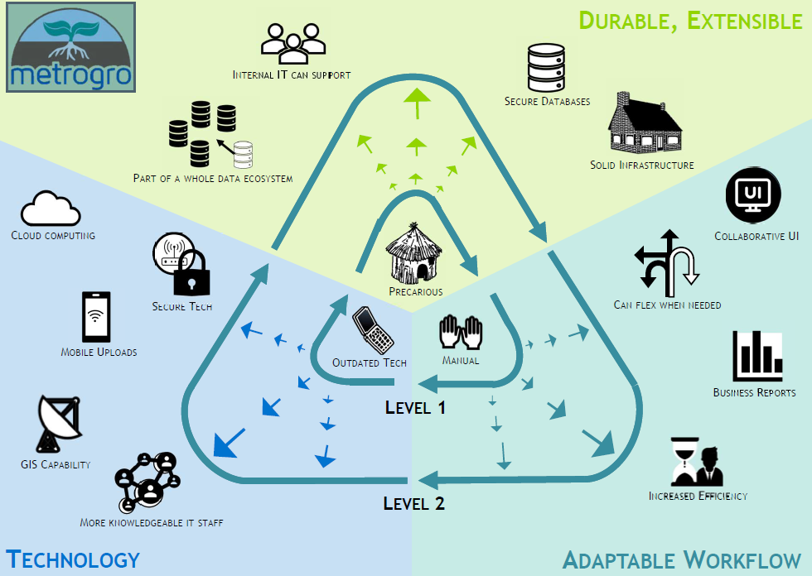
Leveling Up to a New Software System
Notes:
An important part of the user assessment work with Yahara Software, was developing the concept of “leveling up” as a way to understand and communicate the high-level goals for the project
This diagram is one of the outputs from that work.
We are currently at level 1, where we have a precarious system that needs significant stewardship from staff, the technology is outdated and not easily expandable to meet new needs, and we have many manual process.
The goal for our project is to move to Level 2. Some of the highlights of level 2 are…
A Durable and Extensible Framework, this includes
A robust design – one that will minimize risks for failures, and it will keep our data safe
The design must also reflect good standard practices and will support creation of a system that will make it easy for District staff or outside consultants to easily support and enhance the system when needed in the future.
The new system must be able to incorporate modern functions and tools like
Cloud computing, GIS, mobility functions, and cybersecurity protections
The new system will also include tools to support adaptable workflows and intuitive reporting
Workflows will be incorporated into the system’s design so many manual processes can be eliminated
New reporting tools will give users the ability to more easily create and update reports
Regulatory reporting requirements will be transparent and more easily configured when changes are required.

Slide 11
RFP Development
Photo caption here
All-encompassing
Requirements and documentation from the User Assessment
Technical requirements
Management requirements
Specific questions
Agile Scrum approach
Notes:
So, using the results of the user assessment and the leveling up concept, Yahara and the team developed the RFP for the development project.
Our RFP was created to be all-encompassing. We wanted it to provide clear details and requirements to prospective proposers so that the District would receive quality responses.
Not only did the RFP include technical requirements and a timeline, but also requirements for project management, expectations for collaboration, and an extensive list of questions to be answered in the responses.
The RFP also required that the selected consultant use an Agile Scrum approach for the development work. This highly collaborative development process helps to assure core requirements are met. It reduces scope creep, allows early testing by the future users, and it provides regularly scheduled sessions for reflection to improve processes throughout the project.

Slide 12
Two-Step Solicitation Process
Photo caption here
Two rounds of review
Go slow now to go faster later
Ready and committed project team
Technical consideration = Professionalism reflected and collaboration
Notes:
Because the Metrogro project would span multiple years and the work can be very challenging, selecting the right consultant was especially important
We created a 2-step solicitation process to help with this selection.
We knew this would take a bit more time, but we also felt that if we go slow now, and select the right consultant, then we will probably go faster later – meaning we could stick to the project timeline.
The project team was committed to the two-step process to learn as much as possible about the proposing firms and their project approach
During the first step we would be focused on the content of the proposals. And
During the second step we would engage more directly with the consultants through an interview process.

Slide 13
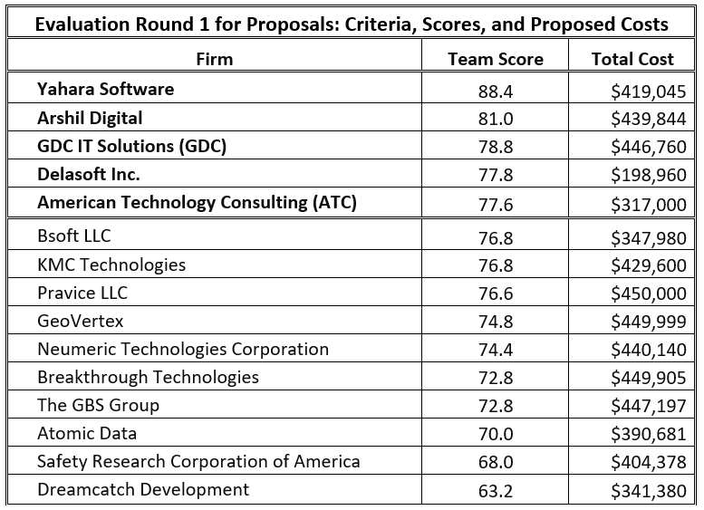
First Round – Review and Evaluation
Photo caption here
Received: 20 proposals
Evaluated: 15 proposals
Evaluation criteria: Ability, Experience, District Involvement, Beneficial Timeline, and Value Pricing
Top 5 scoring firms moved on to 2nd round
Notes:
During our first round of proposal review, we focused on the information contained within the proposals.
We had 20 consultants respond to our RFP, with 5 having proposals that did not meet our core requirements – so those were removed from the process
The remaining 15 proposals were reviewed by the project team.
These were evaluated on Ability, Experience, District Involvement, Beneficial Timeline, and the Value of the Pricing
After evaluation and scoring by the team, the top 5 scoring proposals – highlighted at the top of this listing - were moved on to the second evaluation round

Slide 14
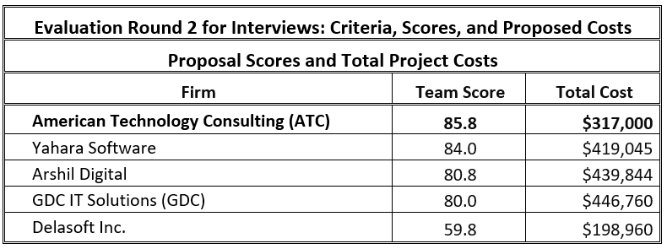
Second Round – Interviews and Questions
Notes:
In the 2nd round, the top 5 firms were invited to an interview with the Metrogro System Development Team. During the interview they had the opportunity to make a presentation that expanded upon their proposals and further explained their approach for our project.
They were also given a list of specific questions to answer during their interviews.
The District’s project team used this round to not only better understand the firm’s project approach, but to also understand more about the firm’s team, skillsets, and the care that they took to understand our project’s needs.
The scoring criteria for this round of evaluation included Approach, Experience, District Involvement and Communications, and Value Pricing.
American Technology Consulting or ATC, was scored the highest by the team and selected as our preferred consultant.

Slide 15
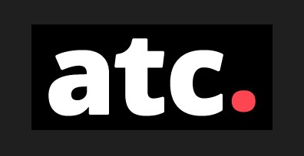
ACT Team and Timeline
Notes:
ATC stood out in the professionalism shown during the interview and their approach that focused on collaboration
The presentation content reflected significant time spent analyzing our RFP and the supplied technical documents.
We felt that they truly understood the project scope and our needs.
Their proposed project staffing also impressed us
They would provide Agile Scrum specialists, and their proposed team would be specifically assigned to our project
The presentation team showed a high interest and respect for our project by having several team members coming on site for the interview
Other things that help ACT rise above the competitors were
Experience with other public sector entities
Experience working with customers in the agricultural area, including using GIS
Extensive experience with Agile Scrum, and they took the time to described how they would use Agile Scrum processes for our project
ATC had the highest score while also having the 2nd lowest cost, reflecting a high value proposal
The proposed timeline aligned with our requirements and respected restrictions of staff time during hauling season.
And the project is scheduled to be complete in January of 2026.

Slide 16
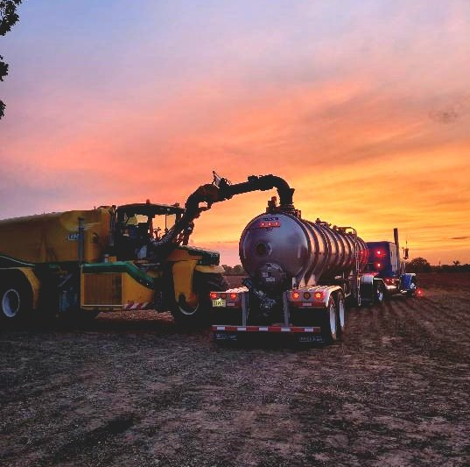
Adopt resolution #2024-08-08-R5
Adopt Resolution #2024-08-08-R5 awarding a contract for the Metrogro Software System Development to ATC for a cost not to exceed $317,000
Agreement to be funded from the 2024, 2025, and 2026 Operational budgets
Notes:
Any questions?

